Slide 1
Smart Vaccum Cleaner Robot using IOT
Guided By :
Dr.K.LALITHA
PRESENTED By :
22AI009-Deepakkumar.M
. 22AI016-Gokulraj.V
. 22AI020-Kavinkumar.G
TEAM NO : 7
22AIC14 : Internet of Things & It’s Application

Slide 2
Abstract
*The Smart Vacuum Cleaner is an autonomous cleaning device designed to simplify household chores.
*It uses sensors for navigation, motors for movement, and IoT for remote control.
* The device efficiently detects obstacles and covers maximum floor area, providing a convenient and time-saving solution for home cleaning.

Slide 3
Objectives:
Develop an Autonomous Cleaning SystemEnable automatic navigation and cleaning without manual intervention.
Integrate Obstacle DetectionUse sensors to detect and avoid obstacles during operation.
Implement IoT FeaturesAllow remote control and scheduling through a mobile app or voice commands.
Optimize Cleaning EfficiencyEnsure the cleaner covers maximum floor area and operates with energy efficiency.

Slide 4
Components Required:
Microcontroller: Manages operations. Sensors: For obstacle detection and cliff avoidance. Motors: For movement and vacuuming. Battery: Powers the device. Charging Dock: For automatic recharging. IoT Module: For remote control (Wi-Fi/Bluetooth). Dustbin: Collects debris.

Slide 5
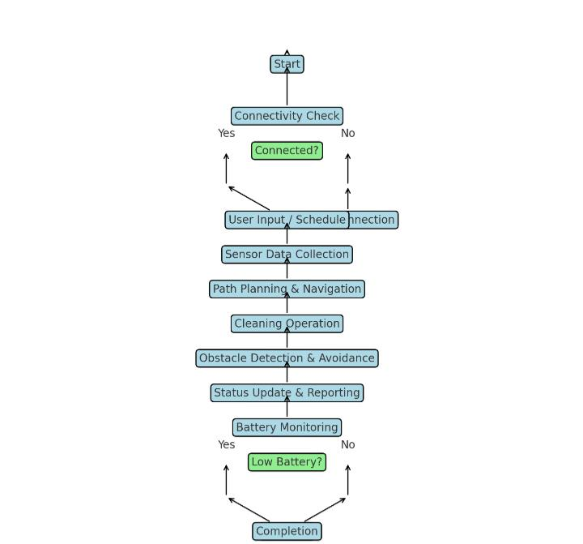
Flow Diagram:

Slide 6
Implementation: (Hardware or software)
Hardware:
Microcontroller: Manages operations.
Sensors: For obstacle and cliff detection.
Motors: For movement and suction.
Battery & Charging Dock: Powers the device and recharges it.
Dustbin: Collects debris.
IoT Module: Enables remote control via Wi-Fi/Bluetooth.
Software:
Firmware: Controls hardware operations and processes data.
Navigation Algorithms: Manages path planning and obstacle avoidance.
Remote Control Interface: Mobile app and/or voice command integration.
Battery Management: Oversees charging and power efficiency

Slide 7
Thank you

